Slide 1
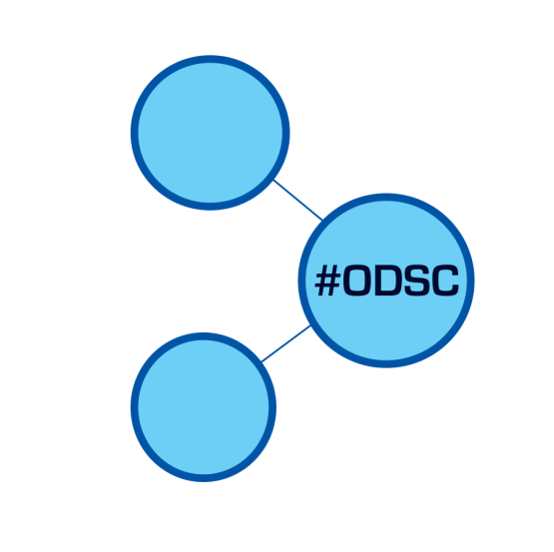
Feature engineering
O P E N
D A T A
S C I E N C E
C O N F E R E N C E_
BOSTON 2015
@opendatasci
David Epstein

Slide 2
Feature Engineering
David Epstein
Senior Data Scientist, Socure
Open Data Science Conference, Boston, MA
May 30-31, 2015
#ODSC, @opendatasci

Slide 3
Talk Outline
What is feature engineering?
Limits on number of features
How to select a “good” set of features
Standard FE techniques
TL;DR: As we get better and better models, focus shifts to what we put into them
FE interacts with other key areas of DS

Slide 4
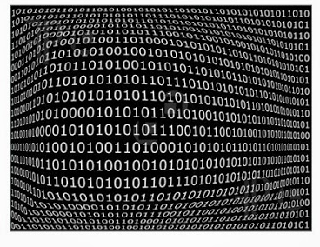

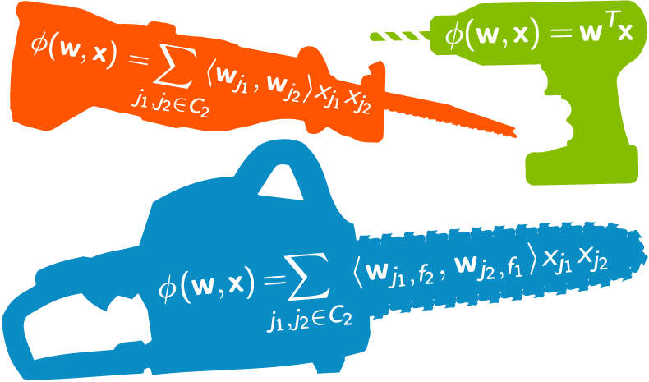

Feature Engineering
(My) Definition: Transforming data to create model inputs.
Data Workflow
Raw
Data
Data
Cleaning
Feature
Engineering
Model
Building
Pre-Processing

Slide 5

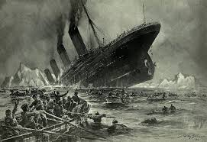
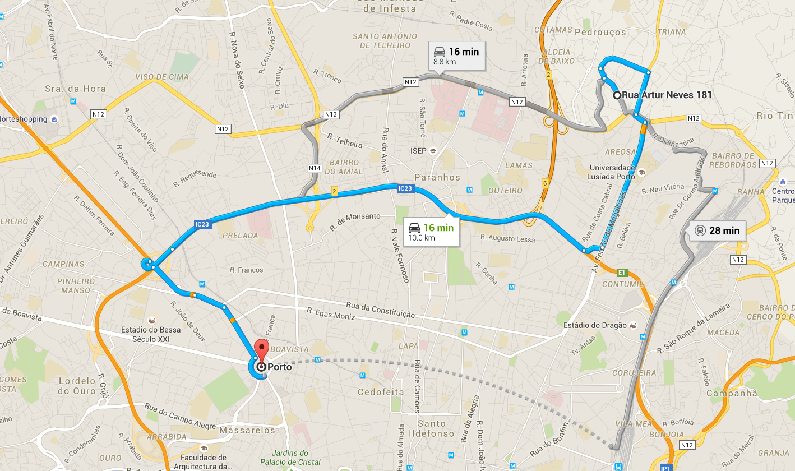
Examples from Kaggle Competitions
Netflix
Titanic
“Golden Features”
Portuguese Taxis

Slide 6
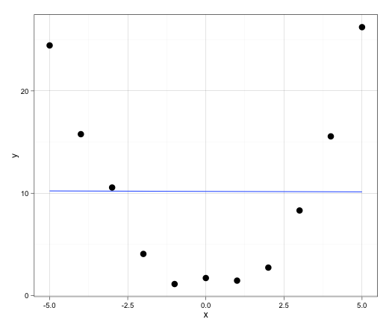
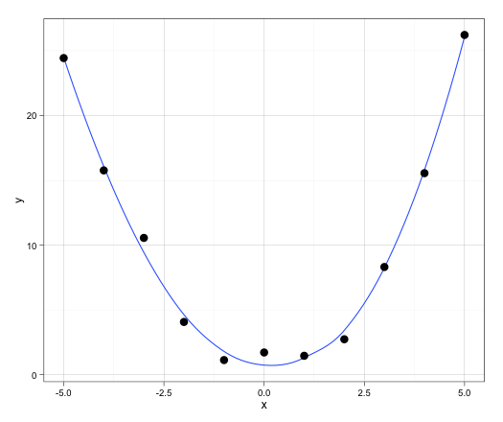
How does it work?
Coefficients:
Estimate Std. Error t value Pr(>|t|)
(Intercept) 10.17912 2.92472 3.48 0.00693 **
x -0.00923 0.92488 -0.01 0.99225
---
Residual standard error: 9.7 on 9 degrees of freedom
Multiple R-squared: 1.107e-05, Adjusted R-squared: -0.11
F-statistic: 9.96e-05 on 1 and 9 DF, p-value: 0.9923
Coefficients:
Estimate Std. Error t value Pr(>|t|)
(Intercept) 0.29879 0.48994 0.61 0.559
x -0.00923 0.10256 -0.09 0.930
x2 0.98803 0.03672 26.91 3.92e-09 ***
---
Residual standard error: 1.076 on 8 degrees of freedom
Multiple R-squared: 0.9891, Adjusted R-squared: 0.9863
F-statistic: 362 on 2 and 8 DF, p-value: 1.427e-08

Slide 7

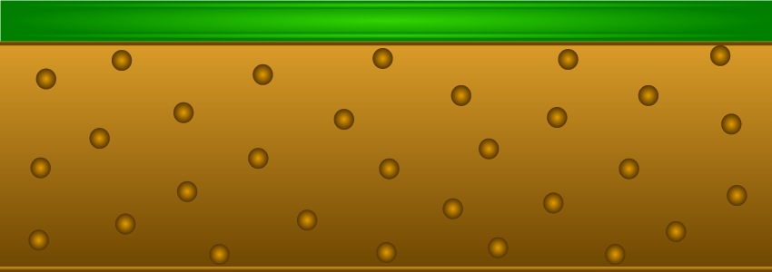
Features are engineered everywhere
Things to be explained/measured/predicted
Finance:
EBITDA
Baseball:
Batting Avg.
Politics:
Partisan Performance
Raw Data
Notes:
Seen in this light, FE is ubiquitous (as all truly important concepts are)
Any time you construct an intermediate variable, you’re doing FE

Slide 8
The Big Questions
Seen in this light, FE is ubiquitous (as all truly important concepts are)
Any time you construct an intermediate variable, you’re doing FE
Two questions naturally arise:
How do you construct “good” features?
What are the limits on this process?
I’ll answer the second one first, because it’s easier….

Slide 9
Limits on Feature Engineering
In medical studies, social science, financial analysis, etc., two main problems emerge
Eating up degrees of freedom: relatively small data sets
# of respondents in survey
# of patients in trial
# of elections to Congress
If your data lives in an NxK matrix, you want to make sure that K is small relative to N
Relevance to hypothesis testing, emphasis on explanation
You generally start with an equation defining the relationship between the key independent and dependent variables
Other variables enter your model as controls, not really interested in their functional form

Slide 10
Limits on Feature Engineering
In most modern data science applications, neither is an issue
We start with lots of data, and
Care more about prediction than explanation
So why not add in lots of extra variables?
Think of your data not as what goes into your model, but a starting point for the creation of new variables, which can then be combined…

Slide 11
Limits on Feature Engineering
First, adding many correlated predictors can decrease model performance
Adding an x⁴ term to above example actually reduces model fit:
Coefficients:
Estimate Std. Error t value Pr(>|t|)
(Intercept) 0.648123 0.628178 1.032 0.336513
x -0.009230 0.103740 -0.089 0.931593
x2 0.866738 0.139087 6.232 0.000432 ***
x4 0.004852 0.005361 0.905 0.395572
---
Residual standard error: 1.088 on 7 degrees of freedom
Multiple R-squared: 0.9902, Adjusted R-squared: 0.986
F-statistic: 236.1 on 3 and 7 DF, p-value: 2.15e-07
More variables make models less interpretable
Models have to be generalizable to other data
Too much feature engineering can lead to overfitting
Close connection between feature engineering and cross-validation

Slide 12
How To Select a “Good” Set of Features
This is the open-ended question in the field
Separate (but related to) the question of feature selection – which variables to retain in a model.
You can use some metrics to tell which features are useful, one at a time, like Pearson correlation coefficient
But this can’t tell you which set of features works best together
This is an NP complete problem, clearly too computationally hard
Many new data analysis services include automated feature engineering as part of their packages
But if there are features you want in your model, it’s best to add them in explicitly, rather than depend on these generators.

Slide 13
A “Middle Theory” of FE
Start with a reasonable-sized set of features
Include features suggested by domain knowledge
Test these out individually, build from the bottom up
Number and type of features depend on model used
Can include more features if models does some feature selection
Lasso regression, e.g., logit with ||L₁|| regularization (but not ||L₂|| ridge)
GBM with backward pruning (but not random forests)
Stepwise regression, with either forward or backward feature selection
Some models are invariant to monotonic variable transformations
Tree-based approaches divide variables into two groups at each branch
So, no perfect answer. But there are some standard techniques every data scientist should have in their bag of tricks.

Slide 14
Non-numeric to numeric
Count # of times each value appears
Zip Code | Count
10024 | 4
63105 | 2
94304 | 1
06443 | 3
10024 | 4
63105 | 2
06443 | 3
10024 | 4
10024 | 4
06443 | 3

Slide 15
Non-numeric to numeric
One-hot encoding
Religion | Catholic | Protestant | Jewish | Muslim
Catholic | 1 | 0 | 0 | 0
Muslim | 0 | 0 | 0 | 1
Jewish | 0 | 0 | 1 | 0
Protestant | 0 | 1 | 0 | 0
Catholic | 1 | 0 | 0 | 0
Catholic | 1 | 0 | 0 | 0
Jewish | 0 | 0 | 1 | 0
Protestant | 0 | 1 | 0 | 0
Muslim | 0 | 0 | 0 | 1
Protestant | 0 | 1 | 0 | 0

Slide 16
Non-numeric to numeric
The “hash trick”
string | h(string)
“The” | 36
“quick” | 8
“brown” | 92
“fox” | 14
“jumps” | 75
“over” | 25
“the” | 36
“lazy” | 44
“dog” | 21

Slide 17

Non-numeric to numeric
Leave-one-out encoding

Slide 18
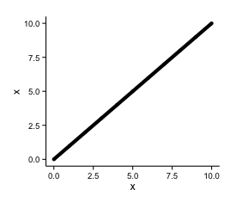
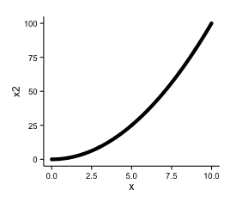
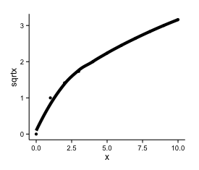
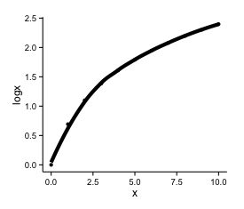
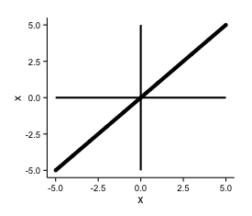
Single Variable Transformations
x
x²
Log(x)
scaling

Slide 19
Two-variable combinations
Add: Sum similar-scaled variables
Q1 | Q2 | Q3 | Q4 | Total
33 | 88 | 51 | 81 | 251
11 | 11 | 72 | 30 | 124
15 | 36 | 70 | 55 | 176
70 | 82 | 8 | 50 | 209
99 | 56 | 35 | 86 | 276
7 | 20 | 10 | 71 | 107
65 | 0 | 25 | 74 | 164
96 | 25 | 2 | 89 | 211
60 | 29 | 56 | 92 | 238
63 | 50 | 96 | 61 | 269

Slide 20
Two-variable combinations
Subtract: Difference relative to baseline
ViewerID | MovieID | Date | Rating | Days Since First Rating
44972004 | 8825 | 1/1/13 | 5 | 0
44972004 | 0471 | 2/1/13 | 4 | 31
44972004 | 3816 | 3/1/13 | 5 | 59
44972004 | 8243 | 4/1/13 | 3 | 90
44972004 | 2855 | 5/1/13 | 5 | 120
44972004 | 9923 | 6/1/13 | 2 | 151
44972004 | 1023 | 7/1/13 | 4 | 181
44972004 | 8306 | 8/1/13 | 3 | 212
44972004 | 2771 | 9/1/13 | 2 | 243
44972004 | 5281 | 10/1/13 | 2 | 273

Slide 21
Two-variable combinations
Multiply: Interactive effects
ViewerID | Country | Domestic | DSFR | Dom*DSFR
8825 | US | 1 | 38 | 38
0471 | CA | 0 | 277 | 0
3816 | FR | 0 | 187 | 0
8243 | US | 1 | 33 | 33
2855 | US | 1 | 87 | 87
9923 | GB | 0 | 42 | 0
1023 | IT | 0 | 192 | 0
8306 | CA | 0 | 365 | 0
2771 | US | 1 | 505 | 505
5281 | FI | 0 | 49 | 0

Slide 22
Two-variable combinations
Divide: Scaling/Normalizing
Country | GDP | Population | GDP/Capita
US | 159849 | 275 | 581
CA | 731812 | 111 | 6593
FR | 826320 | 90 | 9181
IT | 573494 | 80 | 7169
IR | 609223 | 22 | 27692
GB | 717673 | 60 | 11961
NE | 605257 | 15 | 40350
MX | 687944 | 124 | 5548
RU | 203319 | 402 | 506
FI | 744983 | 40 | 18625

Slide 23
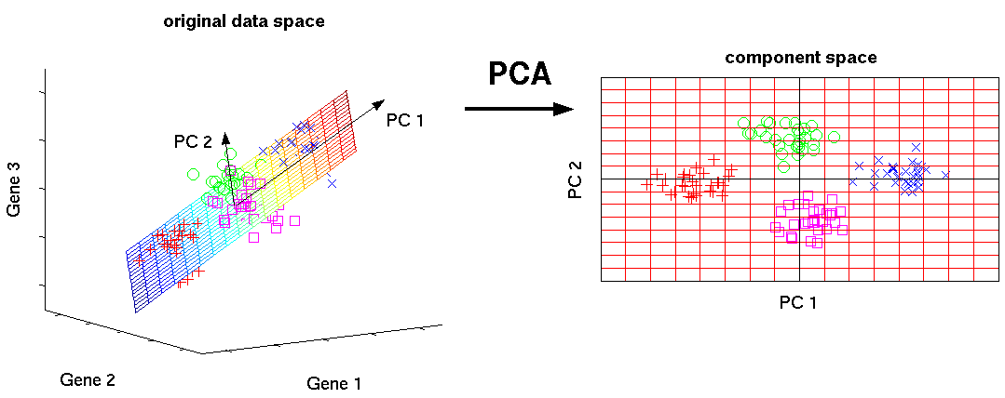
Multivariate/Model-based Methods
PCA/Factor Analysis/Clustering: Dimension reduction

Slide 24
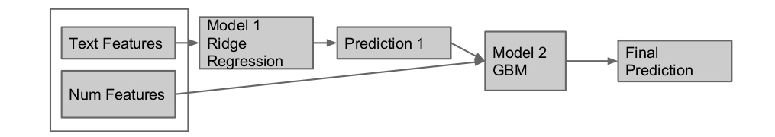
Multivariate/Model-based Methods
Model Stacking: Outputs of one model are inputs to the next
Do this, e.g., on half the data and use as input to the other half, and vice-versa
(Figure from Owen Zhang)

Slide 25
Conclusion
Data science grew over the last decade due to improved modeling algorithms, better cross-validation procedures
Now we have a number of good models, can get at problem from lots of different angles
Most improvement will come from thinking carefully about what we put into our models = Feature Engineering
This can be (semi-) automated, but it’s still one of the true arts of the profession
Domain knowledge remains very important in practice

